Slide 1



Presentation of Project(GF)
Algorithmic tools and software for capturing facial action
Developed by:
Ali TOILHA
Guy-Florent A. SADELER
Arame Viviane BASSE
Supervisors:
Pascal BOURDON
David HELBERT
M1 RTMA 2014/2015

Slide 2
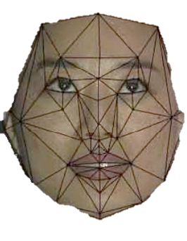
Outline
Introduction
Project environment
Organization and tools
Implementation
Conclusion
Algorithmic tools and software for capturing facial action

Slide 3
I- Project environment (VAB)
Abstract
Presentation of team
Objectives and goals
Algorithmic tools and software for capturing facial action

Slide 4
I- Project environment
Abstract(VAB)
Origin
Applications and end users
Facial recognition : often used
- To secure devices
- Or control the use of applications
It can also be used to secure systems
Algorithmic tools and software for capturing facial action

Slide 5
I- Project environment
Presentation of team and actors(VAB)
The project team includes:
Supervisors :
Pascal BOURDON and David HELBERT
Students in charge (project team) :
Ali TOILHA
Guy-Florent SADELER
Viviane Arame BASSE
End users :
Pascal BOURDON, The product owner and any company requiring.
Algorithmic tools and software for capturing facial action

Slide 6
I- Project environment
Roles (VAB)
Developers : Full team
Project Manager : TOILHA Ali
Communication Manager : BASSE Viviane Arame
Technical Manager : SADELER Guy-Florent
Algorithmic tools and software for capturing facial action

Slide 7
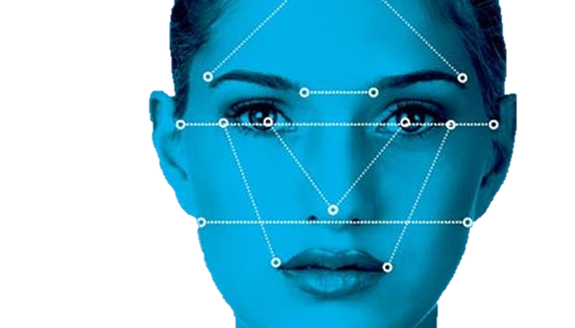
I- Project environment
Scope of work (AT & VAB)
Expected results :
2prototypes in python
facial recognition software developped with Eigenfaces;
facial recognition software developped with Fisherfaces.
Integration of prototype in oriented object Programming language :
Python
Or C ++
Algorithmic tools and software for capturing facial action

Slide 8
II- Organization
Deadline(AT)
Scrum and Methods (Trello, management configuration)
Algorithmic tools and software for capturing facial action

Slide 9
II- Organization
Deadline (AT)
April 09: User requirements delivery and presentation
May 08: Theoretical State of art
May 29: Technical report (version 1)
June 11: Official delivery (technical documents, codes)
June 17: Presentation
Algorithmic tools and software for capturing facial action

Slide 10
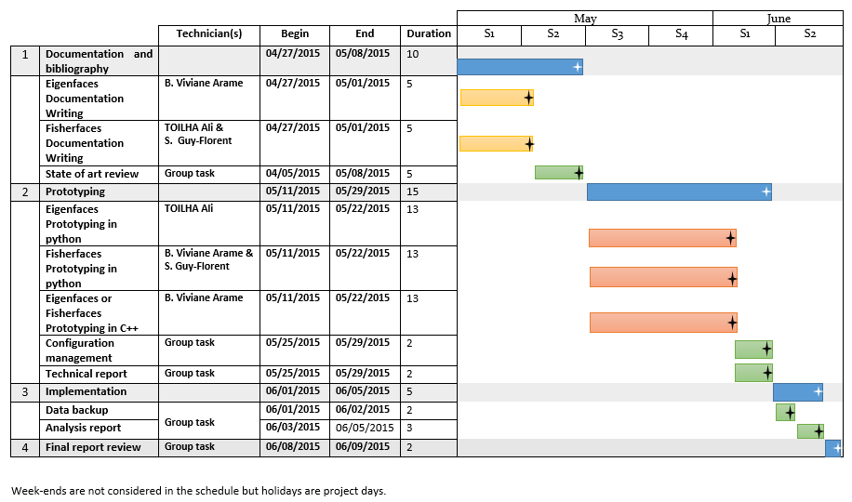
II- Organization
Schedule
Algorithmic tools and software for capturing facial action

Slide 11
II- Organization
Scrum and methods(AT & GFS & VAB)
Backlog
Trello
Scrum
Management configuration
Algorithmic tools and software for capturing facial action

Slide 12
III- Implementation
State of the art Summary (or Brief view pour aperçu)
Product and Service Description
Difficulties
Algorithmic tools and software for capturing facial action

Slide 13
III- Implementation
State of the Art Brief view and logograms (GFS)
is an enhancement of the Eigenfaces
Using FLDA(Fisher’s Linear Discriminante Analysis)
is especially useful when :
facial image have large variations in illumination
facial expression.
Algorithmic tools and software for capturing facial action

Slide 14
III- Implementation
Product and Service Description(Product Owner Order) (GFS)
Prototype of EigenFaces Results
Algorithmic tools and software for capturing facial action

Slide 15
III- Implementation
Product and Service Description(Product Owner Order) (GFS)
Prototype of EigenFaces Results
Algorithmic tools and software for capturing facial action

Slide 16
III- Implementation
Difficulties (GFS)
Algorithmic tools and software for capturing facial action

Slide 17
Conclusion
Summary (GFS)
Prospects
Algorithmic tools and software for capturing facial action

Slide 18
The end
Thank you !
Algorithmic tools and software for capturing facial action

